Slide 1
“Teach A Level Maths”
Statistics 1
Conditional Probability
© Christine Crisp

Slide 2
Statistics 1
AQA
EDEXCEL
MEI/OCR
OCR
"Certain images and/or photos on this presentation are the copyrighted property of JupiterImages and are being used with permission under license. These images and/or photos may not be copied or downloaded without permission from JupiterImages"

Slide 3
We talk about conditional probability when the probability of one event depends on whether or not another event has occurred.
e.g. There are 2 red and 3 blue counters in a bag and, without looking, we take out one counter and do not replace it.
The probability of a 2nd counter taken from the bag being red depends on whether the 1st was red or blue.
Conditional probability problems can be solved by considering the individual possibilities or by using a table, a Venn diagram, a tree diagram or a formula.
Harder problems are most easily solved by using a formula together with a tree diagram.

Slide 4

Notation
P(A) means “the probability that event A occurs”
P(A/) means “the probability that event A does not occur”
P(A B) means
“the probability that event A occurs given that B has occurred”. This is conditional probability.

Slide 5
e.g. 1. The following table gives data on the type of car, grouped by petrol consumption, owned by 100 people.
Low
Medium
High
Total
Male
12
33
7
Female
23
21
4
One person is selected at random.
100
L is the event “the person owns a low rated car”

Slide 6
e.g. 1. The following table gives data on the type of car, grouped by petrol consumption, owned by 100 people.
Low
Medium
High
Total
Male
12
33
7
Female
23
21
4
One person is selected at random.
100
L is the event “the person owns a low rated car”
F is the event “a female is chosen”.

Slide 7
e.g. 1. The following table gives data on the type of car, grouped by petrol consumption, owned by 100 people.
Low
Medium
High
Total
Male
12
33
7
Female
23
21
4
One person is selected at random.
100
L is the event “the person owns a low rated car”
F is the event “a female is chosen”.

Slide 8
e.g. 1. The following table gives data on the type of car, grouped by petrol consumption, owned by 100 people.
Low
Medium
High
Total
Male
12
33
7
Female
23
21
4
One person is selected at random.
100
L is the event “the person owns a low rated car”
F is the event “a female is chosen”.
Find (i) P(L) (ii) P(F and L) (iii) P(F L)
There is no need for a Venn diagram or a formula to solve this type of problem.
We just need to be careful which row or column we look at.

Slide 9


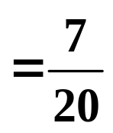


Low
Solution:
Low
Medium
High
Total
Male
12
12
33
7
Female
23
23
21
4
35
100
100
Find (i) P(L) (ii) P(F and L) (iii) P(F L)
( I usually leave the answers as fractions as they won’t always be exact decimals. It’s good practice to cancel. )
(i) P(L) =

Slide 10
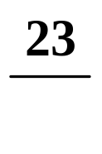

Solution:
Low
Medium
High
Total
Male
12
33
7
Female
23
23
21
4
100
100
Find (i) P(L) (ii) P(F and L) (iii) P(F L)
(i) P(L) =
(ii) P(F and L) =
The probability of selecting a female with a low rated car.

Slide 11

Solution:
Low
Medium
High
Total
Male
12
12
33
7
Female
23
23
21
4
35
100
Find (i) P(L) (ii) P(F and L) (iii) P(F L)
(i) P(L) =
(ii) P(F and L) =
We must be careful with the denominators in (ii) and (iii). Here we are given the car is low rated. We want the total of that column.
(iii) P(F L) =
The probability of selecting a female given the car is low rated.

Slide 12

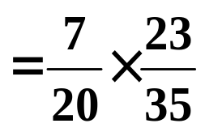
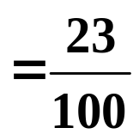

Solution:
Low
Medium
High
Total
Male
12
33
7
Female
23
21
4
100
Find (i) P(L) (ii) P(F and L) (iii) P(F L)
(i) P(L) =
Notice that
(ii) P(F and L) =
P(L) × P(F L)
(iii) P(F L) =
= P(F and L)
So, P(F and L) = P(F L) × P(L)

Slide 13
P(F and L) = P(F L) × P(L)
This result can be used to help solve harder conditional probability problems.
However, I haven’t proved the formula, just shown that it works for one particular problem.
We’ll just illustrate it again on a simple problem using a Venn diagram.

Slide 14
e.g. 2. I have 2 packets of seeds. One contains 20 seeds and although they look the same, 8 will give red flowers and 12 blue. The 2nd packet has 25 seeds of which 15 will be red and 10 blue.
Draw a Venn diagram and use it to illustrate the conditional probability formula.
Solution:
Let R be the event “ Red flower ” and
F be the event “ First packet ”
F
R
Red in the 1st packet

Slide 15
e.g. 2. I have 2 packets of seeds. One contains 20 seeds and although they look the same, 8 will give red flowers and 12 blue. The 2nd packet has 25 seeds of which 15 will be red and 10 blue.
Draw a Venn diagram and use it to illustrate the conditional probability formula.
Solution:
Let R be the event “ Red flower ” and
F be the event “ First packet ”
F
R
8
Red in the 1st packet

Slide 16
e.g. 2. I have 2 packets of seeds. One contains 20 seeds and although they look the same, 8 will give red flowers and 12 blue. The 2nd packet has 25 seeds of which 15 will be red and 10 blue.
Draw a Venn diagram and use it to illustrate the conditional probability formula.
Solution:
Let R be the event “ Red flower ” and
F be the event “ First packet ”
F
R
8
Blue in the 1st packet

Slide 17
e.g. 2. I have 2 packets of seeds. One contains 20 seeds and although they look the same, 8 will give red flowers and 12 blue. The 2nd packet has 25 seeds of which 15 will be red and 10 blue.
Draw a Venn diagram and use it to illustrate the conditional probability formula.
Solution:
Let R be the event “ Red flower ” and
F be the event “ First packet ”
F
R
12
8
Blue in the 1st packet

Slide 18
e.g. 2. I have 2 packets of seeds. One contains 20 seeds and although they look the same, 8 will give red flowers and 12 blue. The 2nd packet has 25 seeds of which 15 will be red and 10 blue.
Draw a Venn diagram and use it to illustrate the conditional probability formula.
Solution:
Let R be the event “ Red flower ” and
F be the event “ First packet ”
F
R
12
8
Red in the 2nd packet

Slide 19
e.g. 2. I have 2 packets of seeds. One contains 20 seeds and although they look the same, 8 will give red flowers and 12 blue. The 2nd packet has 25 seeds of which 15 will be red and 10 blue.
Draw a Venn diagram and use it to illustrate the conditional probability formula.
Solution:
Let R be the event “ Red flower ” and
F be the event “ First packet ”
F
R
12
8
15
Red in the 2nd packet

Slide 20
e.g. 2. I have 2 packets of seeds. One contains 20 seeds and although they look the same, 8 will give red flowers and 12 blue. The 2nd packet has 25 seeds of which 15 will be red and 10 blue.
Draw a Venn diagram and use it to illustrate the conditional probability formula.
Solution:
Let R be the event “ Red flower ” and
F be the event “ First packet ”
F
R
12
8
15
Blue in the 2nd packet

Slide 21
e.g. 2. I have 2 packets of seeds. One contains 20 seeds and although they look the same, 8 will give red flowers and 12 blue. The 2nd packet has 25 seeds of which 15 will be red and 10 blue.
Draw a Venn diagram and use it to illustrate the conditional probability formula.
Solution:
Let R be the event “ Red flower ” and
F be the event “ First packet ”
F
R
12
8
15
10
Blue in the 2nd packet

Slide 22
e.g. 2. I have 2 packets of seeds. One contains 20 seeds and although they look the same, 8 will give red flowers and 12 blue. The 2nd packet has 25 seeds of which 15 will be red and 10 blue.
Draw a Venn diagram and use it to illustrate the conditional probability formula.
Solution:
Let R be the event “ Red flower ” and
F be the event “ First packet ”
F
R
12
8
15
Total: 20 + 25
10

Slide 23
e.g. 2. I have 2 packets of seeds. One contains 20 seeds and although they look the same, 8 will give red flowers and 12 blue. The 2nd packet has 25 seeds of which 15 will be red and 10 blue.
Draw a Venn diagram and use it to illustrate the conditional probability formula.
Solution:
Let R be the event “ Red flower ” and
F be the event “ First packet ”
45
F
R
12
8
15
Total: 20 + 25
10

Slide 24
e.g. 2. I have 2 packets of seeds. One contains 20 seeds and although they look the same, 8 will give red flowers and 12 blue. The 2nd packet has 25 seeds of which 15 will be red and 10 blue.
Draw a Venn diagram and use it to illustrate the conditional probability formula.
Solution:
Let R be the event “ Red flower ” and
F be the event “ First packet ”
45
F
R
12
8
15
10

Slide 25
e.g. 2. I have 2 packets of seeds. One contains 20 seeds and although they look the same, 8 will give red flowers and 12 blue. The 2nd packet has 25 seeds of which 15 will be red and 10 blue.
Draw a Venn diagram and use it to illustrate the conditional probability formula.
Solution:
Let R be the event “ Red flower ” and
F be the event “ First packet ”
45
P(R and F) =
R
F
12
8
15
10

Slide 26

e.g. 2. I have 2 packets of seeds. One contains 20 seeds and although they look the same, 8 will give red flowers and 12 blue. The 2nd packet has 25 seeds of which 15 will be red and 10 blue.
Draw a Venn diagram and use it to illustrate the conditional probability formula.
Solution:
Let R be the event “ Red flower ” and
F be the event “ First packet ”
45
P(R and F) =
R
F
12
8
15
10

Slide 27

e.g. 2. I have 2 packets of seeds. One contains 20 seeds and although they look the same, 8 will give red flowers and 12 blue. The 2nd packet has 25 seeds of which 15 will be red and 10 blue.
Draw a Venn diagram and use it to illustrate the conditional probability formula.
Solution:
Let R be the event “ Red flower ” and
F be the event “ First packet ”
45
P(R and F) =
R
F
12
8
15
10

Slide 28

e.g. 2. I have 2 packets of seeds. One contains 20 seeds and although they look the same, 8 will give red flowers and 12 blue. The 2nd packet has 25 seeds of which 15 will be red and 10 blue.
Draw a Venn diagram and use it to illustrate the conditional probability formula.
Solution:
Let R be the event “ Red flower ” and
F be the event “ First packet ”
45
P(R and F) =
R
F
P(R F) =
12
8
15
10

Slide 29

e.g. 2. I have 2 packets of seeds. One contains 20 seeds and although they look the same, 8 will give red flowers and 12 blue. The 2nd packet has 25 seeds of which 15 will be red and 10 blue.
Draw a Venn diagram and use it to illustrate the conditional probability formula.
Solution:
Let R be the event “ Red flower ” and
F be the event “ First packet ”
45
P(R and F) =
R
F
P(R F) =
P(F) =
12
8
15
10

Slide 30

e.g. 2. I have 2 packets of seeds. One contains 20 seeds and although they look the same, 8 will give red flowers and 12 blue. The 2nd packet has 25 seeds of which 15 will be red and 10 blue.
Draw a Venn diagram and use it to illustrate the conditional probability formula.
Solution:
Let R be the event “ Red flower ” and
F be the event “ First packet ”
45
P(R and F) =
R
F
P(R F) =
P(F) =
12
8
15
10

Slide 31
e.g. 2. I have 2 packets of seeds. One contains 20 seeds and although they look the same, 8 will give red flowers and 12 blue. The 2nd packet has 25 seeds of which 15 will be red and 10 blue.
Draw a Venn diagram and use it to illustrate the conditional probability formula.
Solution:
Let R be the event “ Red flower ” and
F be the event “ First packet ”
45
P(R and F) =
R
F
P(R F) =
P(F) =
12
8
15
10

Slide 32
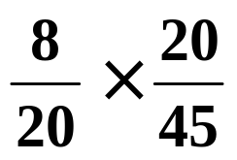
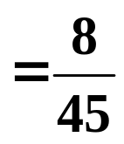


e.g. 2. I have 2 packets of seeds. One contains 20 seeds and although they look the same, 8 will give red flowers and 12 blue. The 2nd packet has 25 seeds of which 15 will be red and 10 blue.
Draw a Venn diagram and use it to illustrate the conditional probability formula.
Solution:
Let R be the event “ Red flower ” and
F be the event “ First packet ”
45
P(R and F) =
R
F
P(R F) =
P(F) =
12
8
15
10
P(R F) × P(F) =
So,
P(R and F) = P(R F) × P(F)

Slide 33
SUMMARY
The probability that both event A and event B occur is given by
P(A and B) = P(A B) × P(B)
We often use this in the form
P(A B) =
P(A and B)
P(B)
In words, this is “the probability of event A given that B has occurred, equals the probability of both A and B occurring divided by the probability of B”.
Reminder:
P(A and B) can also be written as P(A ∩ B)

Slide 34



e.g. 3. In November, the probability of a man getting to work on time if there is fog on the M6 is .
If the visibility is good, the probability is .
The probability of fog at the time he travels is .
(a) Calculate the probability of him arriving on time.
(b) Calculate the probability that there was fog given that he arrives on time.
There are lots of clues in the question to tell us we are dealing with conditional probability.

Slide 35

e.g. 3. In November, the probability of a man getting to work on time if there is fog on the M6 is .
If the visibility is good, the probability is .
The probability of fog at the time he travels is .
(a) Calculate the probability of him arriving on time.
(b) Calculate the probability that there was fog given that he arrives on time.
There are lots of clues in the question to tell us we are dealing with conditional probability.
Solution:
Let T be the event “ getting to work on time ”
Let F be the event “ fog on the M6 ”
Can you write down the notation for the probabilities that we want to find in (a) and (b)?

Slide 36
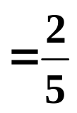
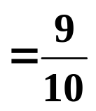
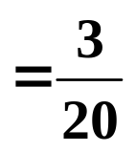
P(T)
(a) Calculate the probability of him arriving on time.
(b) Calculate the probability that there was fog given that he arrives on time.
P(F T)
Can you also write down the notation for the three probabilities given in the question?
“ the probability of a man getting to work on time if there is fog is ”
P(T F)
Not foggy
P(T F/)
“ If the visibility is good, the probability is ”.
“ The probability of fog at the time he travels is ”.
P(F)
This is a much harder problem so we draw a tree diagram.

Slide 37

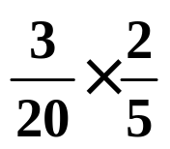
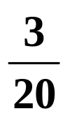



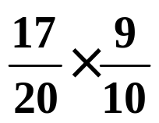
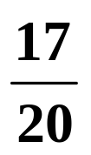

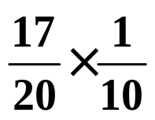
P(T F)
P(T F/)
P(F)
On time
T
F
Fog
Not on time
T/
On time
T
No Fog
F/
Not on time
T/

Slide 38
P(T F)
P(T F/)
P(F)
T
F
T/
T
F/
T/
Because we only reach the 2nd set of branches after the 1st set has occurred, the 2nd set must represent conditional probabilities.

Slide 39
(a) Calculate the probability of him arriving on time.
T
F
T/
T
F/
T/

Slide 40
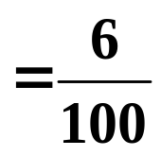
(a) Calculate the probability of him arriving on time.
T
F
( foggy and he arrives on time )
T/
T
F/
T/

Slide 41
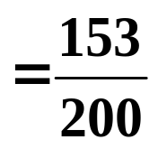
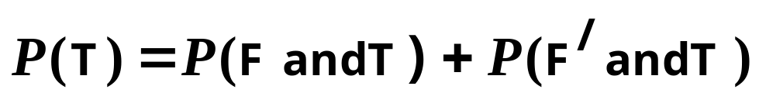
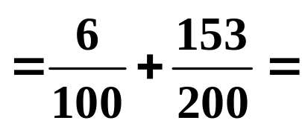
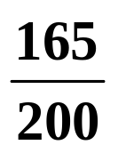

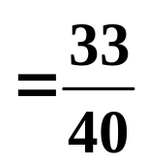

(a) Calculate the probability of him arriving on time.
T
F
T/
T
F/
( not foggy and he arrives on time )
T/

Slide 42
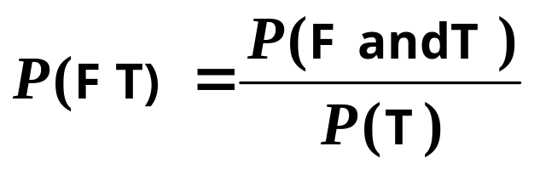

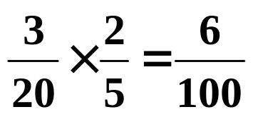


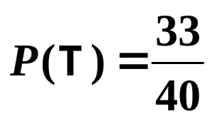
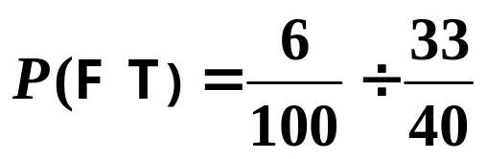

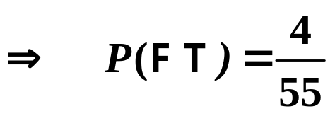
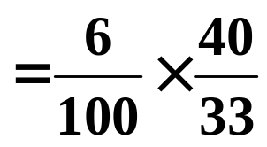



(b) Calculate the probability that there was fog given that he arrives on time.
We need
Fog on M 6
Getting to work
T
F
From part (a),

Slide 43

Exercise
1. A sample of 100 adults were asked how they travelled to work. The results are shown in the table.
 | Walk | Bus | Bike | Car
Men | 10 | 12 | 6 | 26
Women | 7 | 18 | 4 | 17
Total |  |  |  |  | 100
One person is picked at random.
M is the event “the person is a man”
C is the event “the person travels by car”
P(M)
P(M C)
P(M/ and C)
P(C M/)
Find (i) (ii) (iii) (iv)

Slide 44
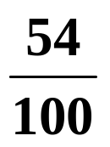
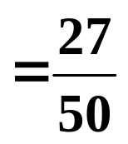
Solution:
Walk
Bus
Bike
Car
Men
10
12
6
26
54
Women
7
18
4
17
Total
100
100
P(M)
P(M C)
P(M/ and C)
P(C M/)
Find (i) (ii) (iii) (iv)
(i)
P(M C) =
(i)
P(M) =
(ii)

Slide 45
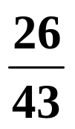
Solution:
Walk
Bus
Bike
Car
Men
10
12
6
26
54
Women
7
18
4
17
Total
43
100
P(M)
P(M C)
P(M/ and C)
P(C M/)
Find (i) (ii) (iii) (iv)
(i)
P(M C) =
P(M) =
(ii)
(iii)
P(M/ and C) =

Slide 46
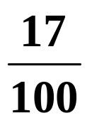
Solution:
Walk
Bus
Bike
Car
Men
10
12
6
26
54
Women
7
18
4
17
Total
43
100
100
P(M)
P(M C)
P(M/ and C)
P(C M/)
Find (i) (ii) (iii) (iv)
(i)
P(M C) =
P(M) =
(ii)
(iii)
(iv)
P(C M/) =
P(M/ and C) =

Slide 47
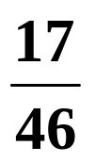
Solution:
Walk
Bus
Bike
Car
Men
10
12
6
26
54
Women
7
18
4
17
46
Total
43
100
P(M)
P(M C)
P(M/ and C)
P(C M/)
Find (i) (ii) (iii) (iv)
(i)
P(M C) =
P(M) =
(ii)
(iii)
(iv)
P(C M/) =
P(M/ and C) =

Slide 48



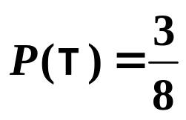
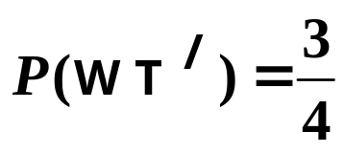
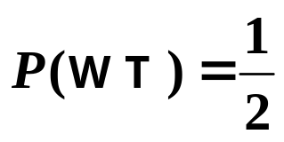
Exercise
2. The probability of a maximum temperature of 28° or more on the 1st day of Wimbledon ( tennis competition! )
has been estimated as . The probability of a particular British player winning on the 1st day if it is below 28° is estimated to be but otherwise only .
Draw a tree diagram and use it to help solve the following:
(i) the probability of the player winning,
(ii) the probability that, if the player has won, it was at least 28°.
Solution:
Let T be the event “ temperature 28° or more ”
Let W be the event “ player wins ”
Then,

Slide 49

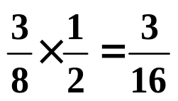


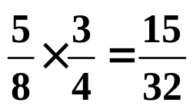

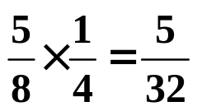

Let T be the event “ temperature 28° or more ”
Let W be the event “ player wins ”
Then,
Wins
W
High temp
T
Loses
W/
Sum = 1
W
Wins
Lower temp
T/
W/
Loses

Slide 50
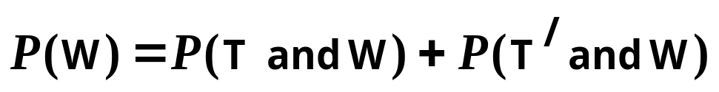
W
T
W/
W
T/
W/
(i)

Slide 51
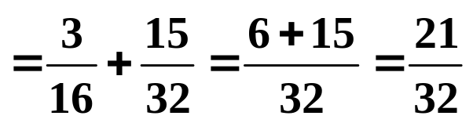
W
T
W/
W
T/
W/
(i)

Slide 52
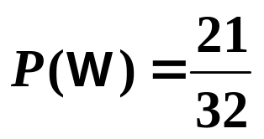
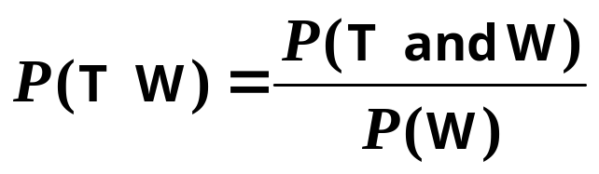
W
T
W/
W
T/
W/
(ii)

Slide 53
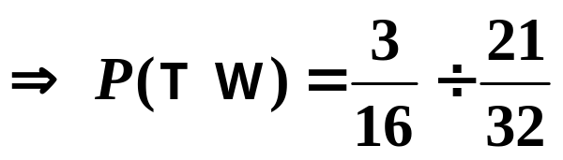
W
T
W/
W
T/
W/
(ii)

Slide 54


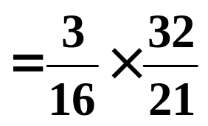
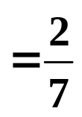

W
T
W/
W
T/
W/
(ii)

Slide 55
We can deduce an important result from the conditional law of probability:
If B has no effect on A, then, P(A B) = P(A) and we say the events are independent.
( The probability of A does not depend on B. )
P(A B) =
P(A and B)
So,
P(B)
P(A and B)
becomes P(A) =
P(B)
or P(A and B) = P(A) × P(B)

Slide 56
SUMMARY
For 2 independent events,
P(A B) = P(A)
So,
P(A and B) = P(A) × P(B)

Slide 57


Slide 58
The following slides contain repeats of information on earlier slides, shown without colour, so that they can be printed and photocopied.
For most purposes the slides can be printed as “Handouts” with up to 6 slides per sheet.

Slide 59

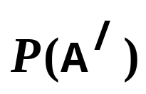

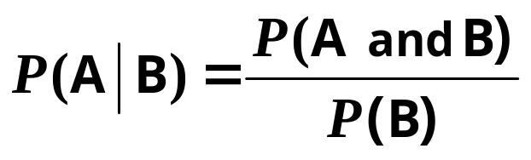
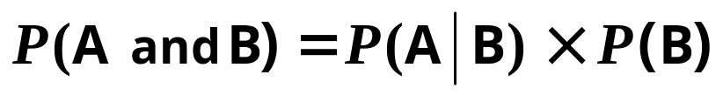

SUMMARY
means “ the probability that event A occurs ”
means “ the probability that event A does not occur ”
means “ the probability that event A occurs given that B has occurred ”
In words, this is “ the probability of event A given that B has occurred, equals the probability of both A and B occurring divided by the probability of B ”.
Rearranging:
Reminder:
P(A and B) can also be written as

Slide 60
e.g. 1. The following table gives data on the type of car, grouped by petrol consumption, owned by 100 people.
Low
Medium
High
Total
Male
12
33
7
Female
23
21
4
One person is selected at random.
100
L is the event “the person owns a low rated car”
F is the event “a female is chosen”.
Find (i) P(L) (ii) P(F and L) (iii) P(F L)
There is no need for a Venn diagram or a formula to solve this type of problem.
We just need to be careful which row or column we look at.

Slide 61
Solution:
Low
Medium
High
Total
Male
12
33
7
Female
23
21
4
100
Find (i) P(L) (ii) P(F and L) (iii) P(F L)
(i) P(L) =
Notice that
(ii) P(F and L) =
P(L) × P(F L)
(iii) P(F L) =
= P(F and L)
So, P(F and L) = P(F L) × P(L)

Slide 62
e.g. 2. I have 2 packets of seeds. One contains 20 seeds and although they look the same, 8 will give red flowers and 12 blue. The 2nd packet has 25 seeds of which 15 will be red and 10 blue.
Draw a Venn diagram and use it to illustrate the conditional probability formula.
Solution:
Let R be the event “ red flower ” and
F be the event “ 1st packet ”
45
P(R and F) =
R
F
P(R F) =
P(F) =
12
8
15
10
P(R F) × P(F) =
So,
P(R and F) = P(R F) × P(F)

Slide 63
e.g. 3. In November, the probability of a man getting to work on time if there is fog on the M6 is .
If the visibility is good, the probability is .
The probability of fog at the time he travels is .
(a) Calculate the probability of him arriving on time.
(b) Calculate the probability that there was fog given that he arrives on time.
Solution:
Let T be the event “ getting to work on time ”
Let F be the event “ fog on the M6 ”

Slide 64
(a) Calculate the probability of him arriving on time.
T
F
T/
T
F/
T/

Slide 65
(b) Calculate the probability that there was fog given that he arrives on time.
We need
Fog on M 6
Getting to work
T
F
From part (a),

Slide 66

If B has no effect on A, then, P(A B) = P(A) and we say the events are independent.
( The probability of A does not depend on B. )
So, for 2 independent events,

